Slide 1
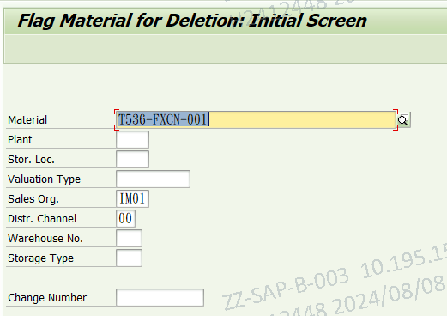
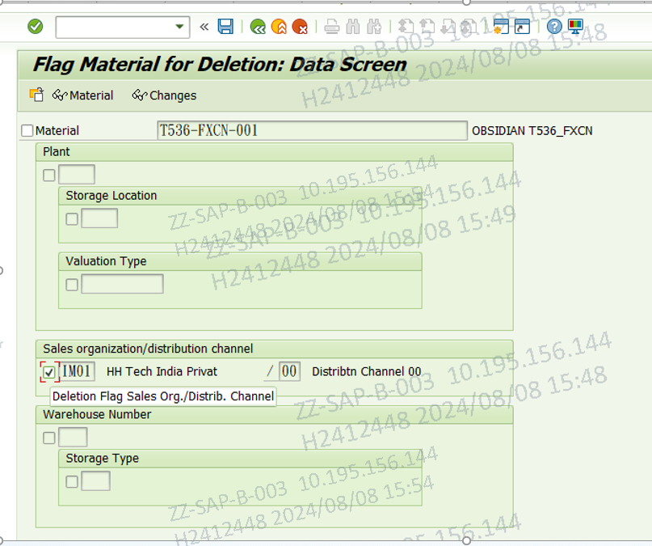
MM06 :Set Material delete Flag –Select Sales organization/ distribution channel
2
1
Pls input the material of the need to be deleted

Slide 2
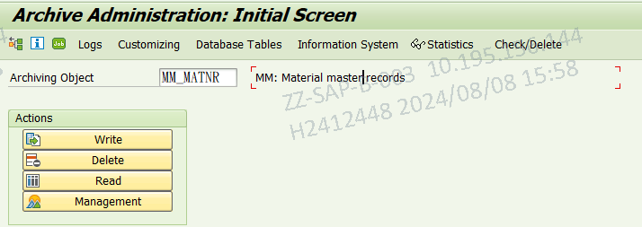
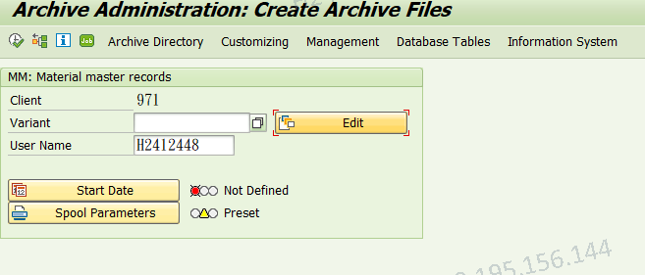
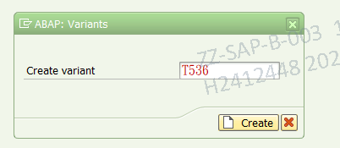
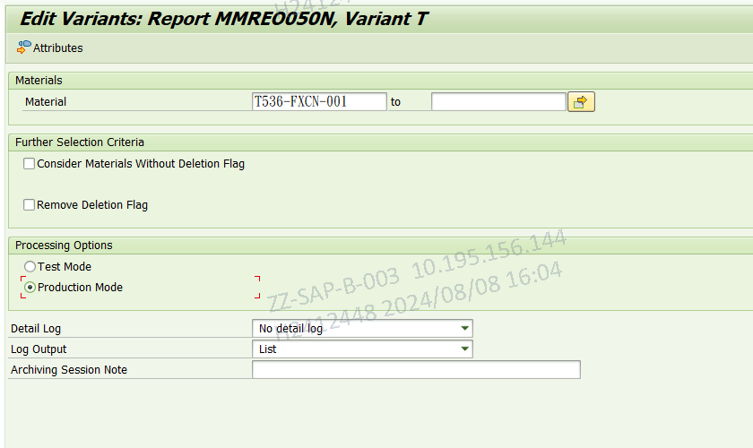
SARA ：Archiving Material master MM-MATNR
Pls click the Edit Button,then enter to the maintenance variant screen
3
4
6
5
Pls input the material number of the need to be archived
7

Slide 3
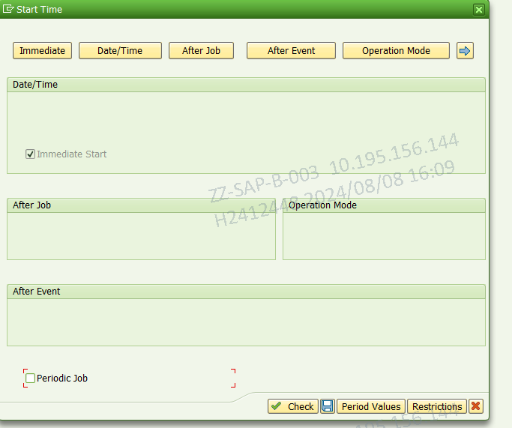
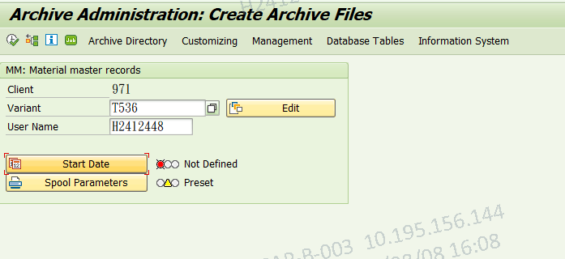
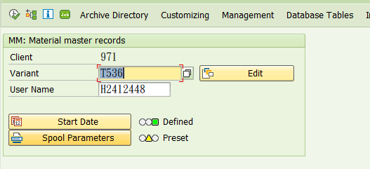
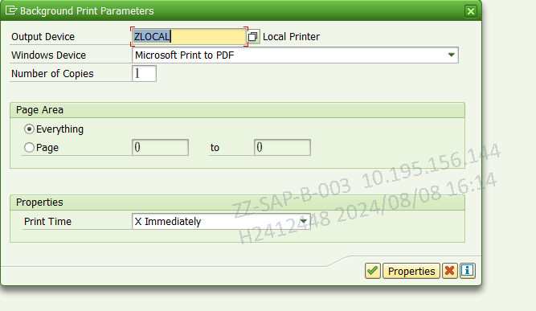
Start Archive JOB
9
8
Pls set the job execution time
13
10
11
Pls set the job output device
12

Slide 4
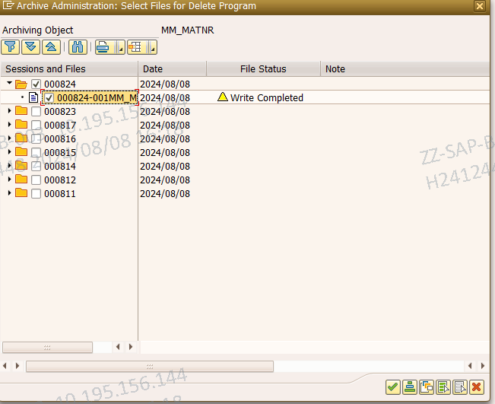
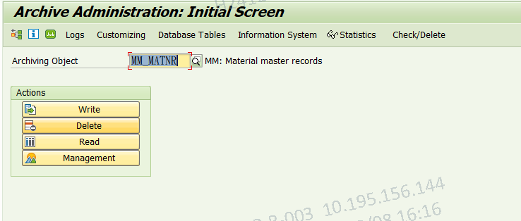
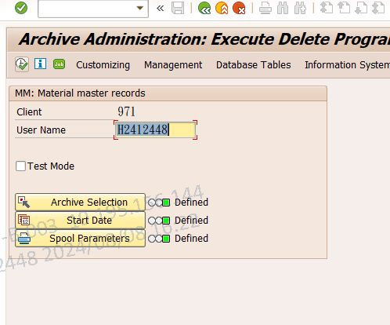
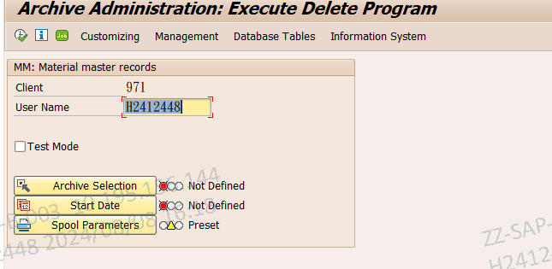
DELETE Archive object
14
19
16
15
17
Step17:Pls set the job execution time
18
Step18:Pls set the job output device
Step19:Pls start the delete job

